Slide 1
Fourier Series

Slide 2
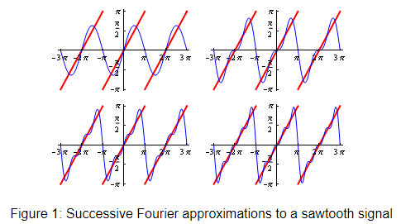
Motivation (Example)
Approximate arbitrary data using linear combination of functions
* http://wwwf.imperial.ac.uk/metric/metric_public/fourier_theory/index.html

Slide 3
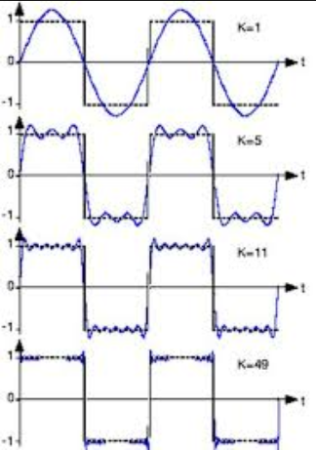
Motivation (Example)
Approximate arbitrary data using linear combination of functions

Slide 4
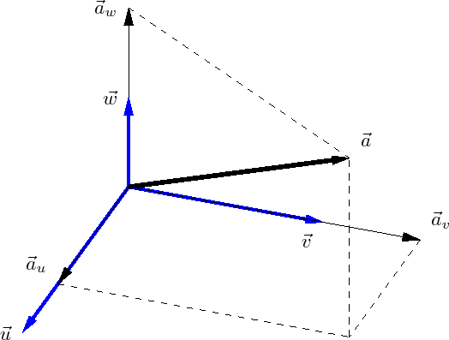
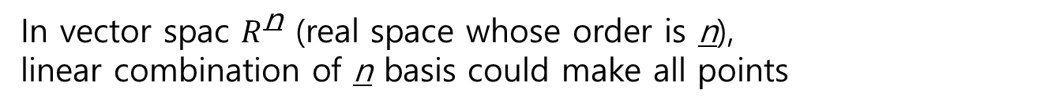
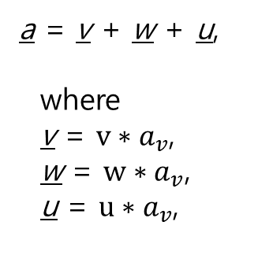
Recap.
In vector spac $R^{\text{n}}$ (real space whose order is n),
linear combination of n basis could make all points
a = v + w + u,
where
v = $v∗a_{v}$,
w = $w∗a_{v}$,
u = $u∗a_{v}$,
* http://www.mathematics-online.org/kurse/kurs8/seite21.html

Slide 5
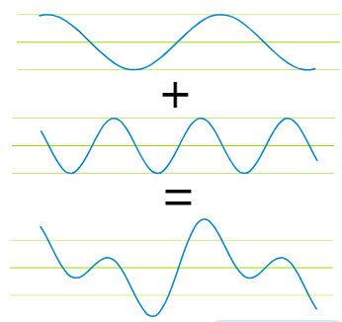
Recap.
In vector spac $R^{\text{n}}$ (real space whose order is n),
linear combination of n basis could make all points
Likewise in real space, orthogonal functions could make all functions
a = v + w
v
w
a
https://www.mathsisfun.com/calculus/fourier-series.html
https://www.youtube.com/watch?time_continue=5&v=7JRwjCpKewQ

Slide 6
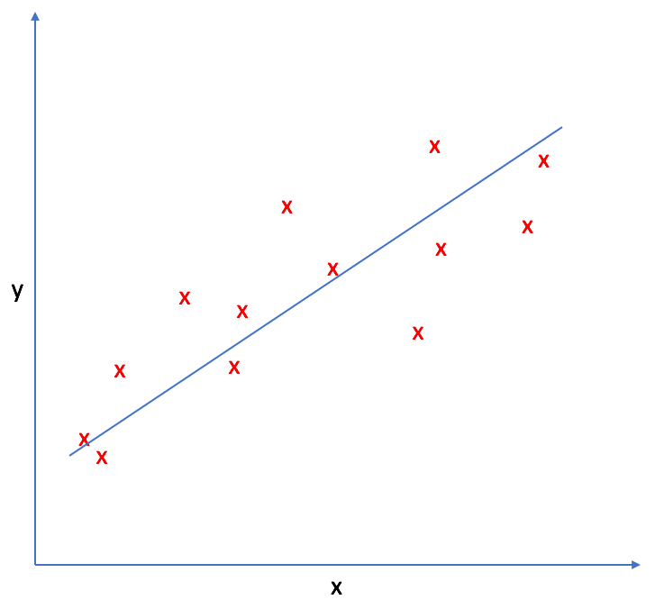
Idea
Approximate arbitrary data (generated by specific function) using linear combination of orthogonal functions
-. same as linear regression
data estimated
weights
(bias) weight
Y = W*X + b
inputs (orthogonal functions)
* https://www.jeremyjordan.me/linear-regression/

Slide 7

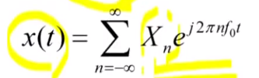
Principle Idea
Approximate arbitrary data (generated by specific function) using linear combination of orthogonal functions
-. Fourier use exponential functions as orthogonal functions
data estimated
weights
idea of fourier
inputs (orthogonal functions)
https://news.cnrs.fr/articles/joseph-fourier-is-still-transforming-science
https://www.youtube.com/watch?v=lhWs6ELlGco

Slide 8
Principle Idea
Approximate arbitrary data (generated by specific function) using linear combination of orthogonal functions
-. Fourier use exponential functions as orthogonal functions
In real space, the num of orthogonal basis is infinity
data estimated
weights
idea of fourier
inputs (orthogonal functions)
linear
combination
https://news.cnrs.fr/articles/joseph-fourier-is-still-transforming-science
https://www.youtube.com/watch?v=lhWs6ELlGco

Slide 9
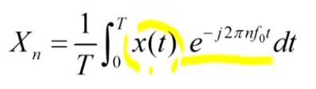
Principle Idea
Weights is correlation score of data (estimated) and orthogonal functions
-. that is, if some orthogonal function related to data have more weight score
data estimated
weights
idea of fourier
weights is correlation score of data (estimated) and orthogonal functions
https://news.cnrs.fr/articles/joseph-fourier-is-still-transforming-science
https://www.youtube.com/watch?v=lhWs6ELlGco

Slide 10
Principle Idea
Weights is correlation score of data (estimated) and orthogonal functions
-. that is, if some orthogonal function related to data have more weight score
Integral term means inner product of a, b
in here
a = x(t)
b = orthogonal exponential function
inner product of a, b is similar to correlation (same when norm of a, b is 1)
data estimated
weights
idea of fourier
weights is correlation score of data (estimated) and orthogonal functions
https://news.cnrs.fr/articles/joseph-fourier-is-still-transforming-science
https://www.youtube.com/watch?v=lhWs6ELlGco

Slide 11
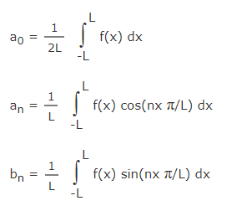


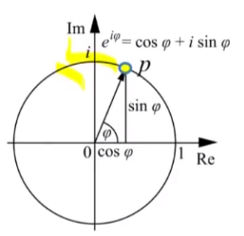
etc.
mean of data
weight (Xn) on cosine part
weight (Xn) on sine part
bias term
(if n = 0)
Exponential function is exchangeable with combination of cosine & sine by Euler formula
data estimated
weights
idea of fourier
weights is correlation score of data (estimated) and orthogonal functions
https://www.mathsisfun.com/calculus/fourier-series.html
https://www.youtube.com/watch?v=lhWs6ELlGco

Slide 12
Reference (Korean)
https://www.youtube.com/watch?time_continue=5&v=7JRwjCpKewQ
https://www.youtube.com/watch?v=lhWs6ELlGco

